Slide 1
Database Layer
School of Decision Sciences
Wipro Technology

Slide 2
Creating Tables
create table "Customer_Information"(
ID Integer CONSTRAINT constraint_name PRIMARY KEY,,
LIMIT_BAL Integer,
SEX Integer,
EDUCATION Integer,
MARRIAGE Integer,
AGE Integer,
Default_Payment Integer
)
Customer Information Table
create table "Past_payment_Type"(
ID Integer CONSTRAINT constraint_name PRIMARY KEY,,
PAY_1 Integer,
PAY_2 Integer,
PAY_3 Integer,
PAY_4 Integer,
PAY_5 Integer,
PAY_6 Integer
)
Past Payment Type Records

Slide 3
Creating Tables
create table "Bill_amount"(
ID Integer CONSTRAINT constraint_name PRIMARY KEY,,
BILL_AMT1 Integer,
BILL_AMT2 Integer,
BILL_AMT3 Integer,
BILL_AMT4 Integer,
BILL_AMT5 Integer,
BILL_AMT6 Integer
)
Bill Amount details
create table "Previous_Payment _Amount"(
ID Integer CONSTRAINT constraint_name PRIMARY KEY,,
PAY_AMT1 Integer,
PAY_AMT2 Integer,
PAY_AMT3 Integer,
PAY_AMT4 Integer,
PAY_AMT5 Integer,
PAY_AMT6 Integer
)
Previous Payment Amount Records

Slide 4
Importing Data from CSV file to SQL
Importing Customer Information into table
copy "Customer_Information"(ID, LIMIT_BAL, SEX,EDUCATION,MARRIAGE,AGE,Default_Payment) FROM 'C:\Users\Pawan\Desktop\PostGERDST\Customer_Information.csv' CSV HEADER DELIMITER ',';
Importing Past Payment type records into table
copy "Past_payment_Type"(ID, PAY_1, PAY_2,PAY_3,PAY_4,PAY_5,PAY_6) FROM 'C:\Users\Pawan\Desktop\PostGERDST\Past_payment_Type.csv' CSV HEADER DELIMITER',';
Importing Outstanding bill amount into table
copy "Bill_amount"(ID, BILL_AMT1, BILL_AMT2,BILL_AMT3,BILL_AMT4,BILL_AMT5,BILL_AMT6) FROM 'C:\Users\Pawan\Desktop\PostGERDST\Bill_amount.csv' CSV HEADER DELIMITER ',';
Importing Previous payment history into table
copy "Previous_Payment _Amount"(ID, PAY_AMT1, PAY_AMT2,PAY_AMT3,PAY_AMT4,PAY_AMT5,PAY_AMT6) FROM 'C:\Users\Pawan\Desktop\PostGERDST\Previous_Payment _Amount.csv' CSV HEADER DELIMITER ',';

Slide 5
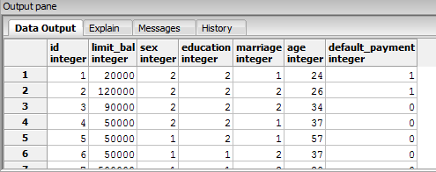
Customer Information details

Slide 6
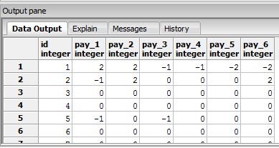
Past Payment Type Records

Slide 7
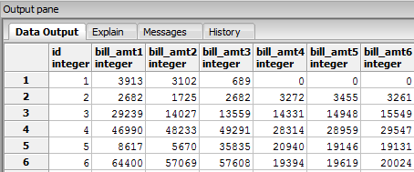
Bill Amount details

Slide 8
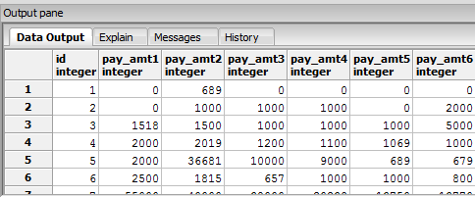
Previous Payment Amount Records

Slide 9
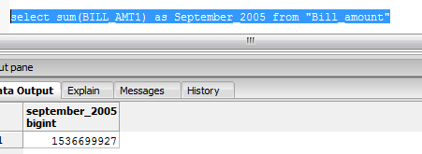
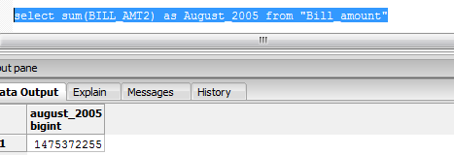
Outstanding Amount Trends In Each Months
Outstanding Amount in September,2005
Outstanding Amount in August,2005

Slide 10
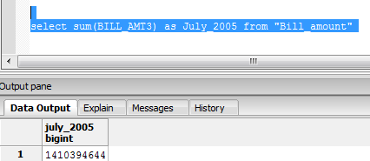
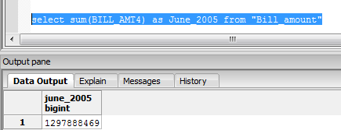
Outstanding Amount Trends In Each Months
Outstanding Amount in July,2005
Outstanding Amount in June,2005

Slide 11
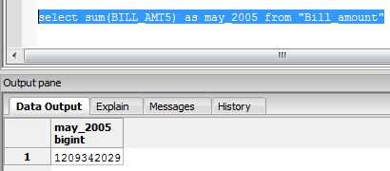
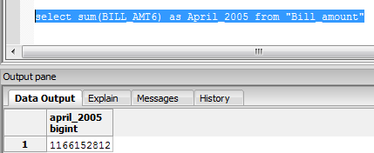
Outstanding Amount Trends In Each Months
Outstanding Amount in May,2005
Outstanding Amount in April,2005

Slide 12
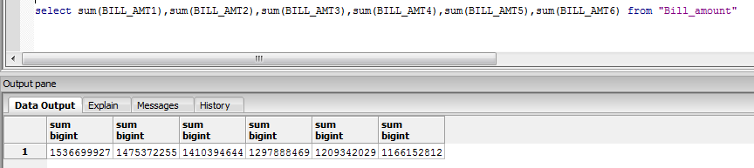
Outstanding Amount Trends
Outstanding Amount Trends from Sept to Apr,2005

Slide 13
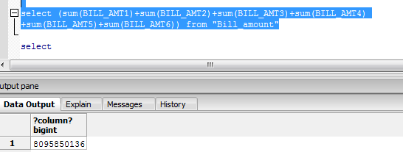
Total Outstanding Amount

Slide 14
Outstanding Amount Trends
Outstanding Amount in May,2005
Outstanding Amount in April,2005

